Slide 1
What is a web framework?

Slide 2
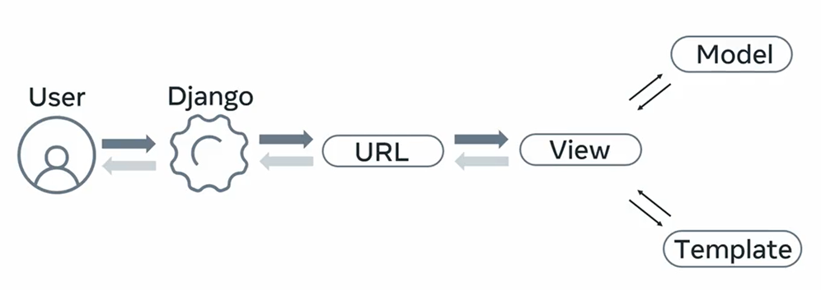

Slide 3
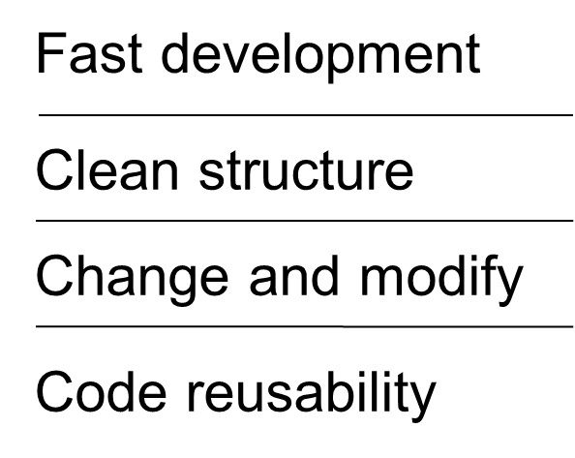

Slide 4
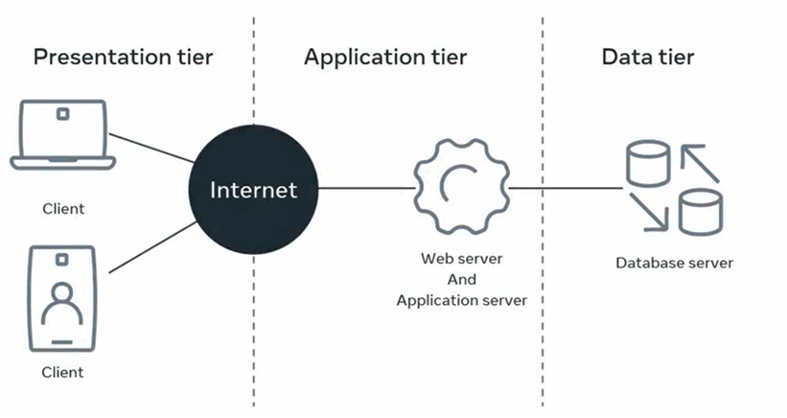

Slide 5
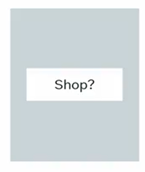
Static Website
User sign-in
HTML
Payment transaction
CSS
Security
JavaScript
Performance
Form data

Slide 6
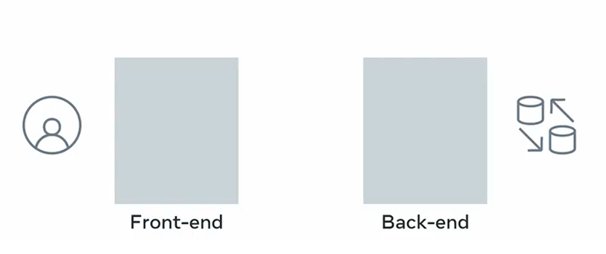
Dynamic website

Slide 7
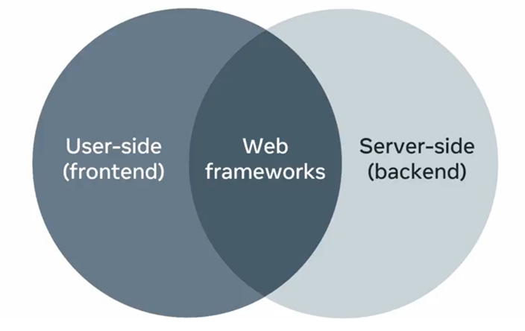

Slide 8

Web framework
Solid foundation

Slide 9


Slide 10


Slide 11
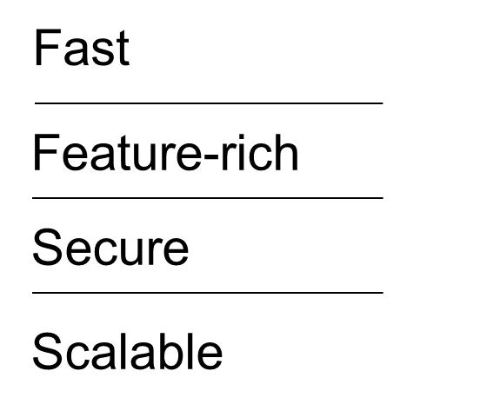

Slide 12

Three-tier architecture

Slide 13
